Slide 1

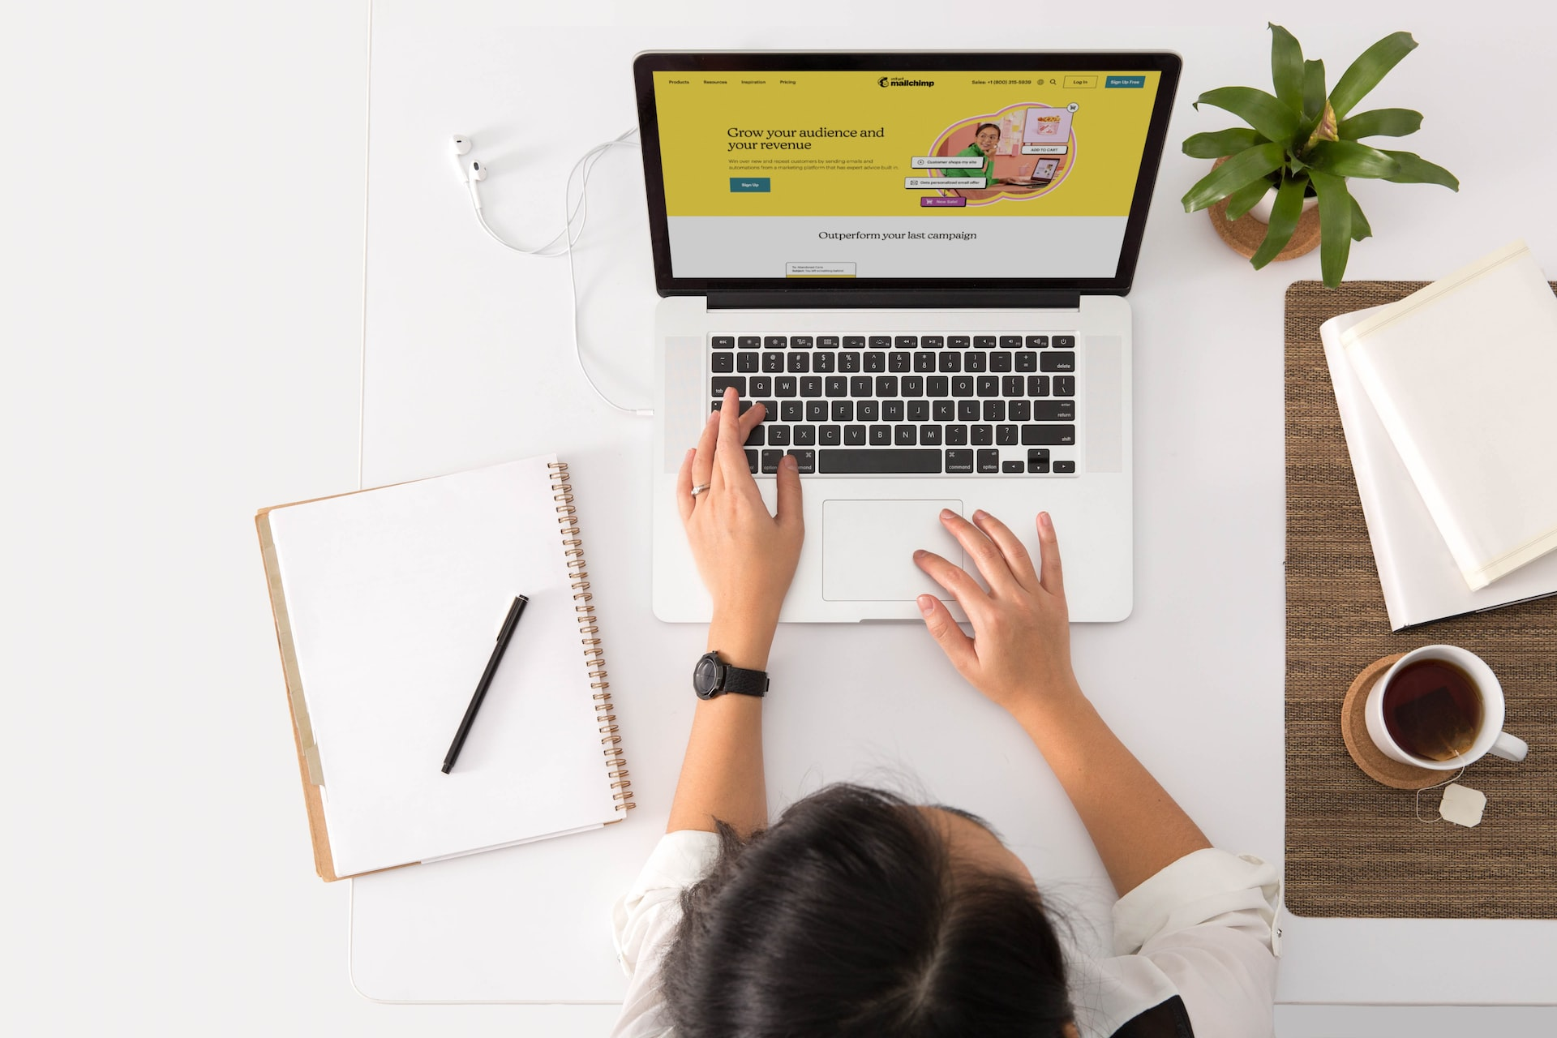
My desk

Slide 2
Laptop
No need to get more into it , u must be probably watching this on a laptop too.😁

Slide 3
Earphones
A pair of hooked thing that goes straight into the ears which u use to hear things basically without actually disturbing the outsiders . Anyways u got yourself a pair too , well use that …🎶

Slide 4
Pen
Seriously , Do I need to let u know what this thing is
This is something u need to scribble your ideas (unlike shit as mine), on a paper.

Slide 5
Coffee
Aah , this is something I need you to know . This thing here is a fuel to rocket engines used in NASA .. U still reading this stuff and believing !! Its just a coffee , which keeps me awake because I don’t sleep at night (I invent such type of shit to work upon).

Slide 6
My desk

